Slide 1
How to Overcome Barriers and Misconceptions of STEM Education in the United States
Md. Mokter Hossain
University of Nevada, Reno
&
Dr. Michael G. Robinson
University of Nevada, Reno
23rd SITE International Conference
Austin, Texas, March 5-9, 2012

Slide 2
How to Overcome Barriers and Misconceptions of STEM Education in the United States
Overview
Introduction
Statement of the Problem
The Basis of Career Choices by U.S. Students
STEM Workforce in the US Job Market
American Students’ Participation Rate in STEM
Barriers and Misconceptions of US STEM Education
How to Overcome these Barriers and Misconceptions
Conclusions & Q/A

Slide 3
How to Overcome Barriers and Misconceptions of STEM Education in the United States
Introduction
STEM refers to the areas of Science, Technology, Engineering, and Mathematics
The US is Considered to be the leader of STEM Education
American Students’ Participation Rate in STEM Careers is not Satisfactory at all
The U.S. is largely dependent on the foreign-born STEM workforce

Slide 4
How to Overcome Barriers and Misconceptions of STEM Education in the United States
Statement of the Problem
Is the U.S. Producing enough STEM workers to meet the nation’s current demand?
Too many highly paid US STEM jobs are occupied by the foreign or foreign-born workers
Is the US Satisfied with its own STEM workforce?
Should the US continue its dependence on other countries for its STEM workers?
How to Solve this Problem?

Slide 5
How to Overcome Barriers and Misconceptions of STEM Education in the United States
Foreign-born STEM Workforce in the U.S.
In 1974, only 11% of doctorate recipients were non-U.S. citizens.
In 2005-06 session, non-U.S. citizens received more than 58% of all engineering doctorates, 44.5% of physical science and 27.4% of life science doctorates
In 2005-2006, 96,981 foreign Professors on U.S. Campuses – Majority were in STEM

Slide 6
How to Overcome Barriers and Misconceptions of STEM Education in the United States
American Students’ Participation Rate in STEM
In 2006, Only 8% of college students choose STEM-related majors
Between 2005-06 and 2006-07, the number of new students declaring CS as a major decreased by 43%
The proportion of 24-year-olds who earn degrees in STEM fields in the U.S. ranks 20th in the world.
15-year-olds in the U. S. ranked 17th on science, and 24th on the math test.

Slide 7
How to Overcome Barriers and Misconceptions of STEM Education in the United States
The Basis of Career Choices by US Students
A great number of US students believe that a college degree is a sufficient for a rewarding job
Most US students like arts, literatures, business, and entertainment related classes and careers
Parents, Teachers, Counselors, and Friends are Major Influencing Bodies for Career Choice
About 90% of the American Parents do not have a great influence on their Children’s career Choice
Many US students and parents believe that STEM studies require significant investment and hard work

Slide 8
How to Overcome Barriers and Misconceptions of STEM Education in the United States
Major Barriers of STEM Education in the US
Curriculum, credit and funding issues
Lack of qualified STEM teachers
Inadequate policies to recruit and retain STEM-Educated teachers
Difficulty to retain teachers with a STEM background
Difficulty in conducting research while teaching in the classroom

Slide 9
How to Overcome Barriers and Misconceptions of STEM Education in the United States
Major Barriers of STEM Education in the US
Difficulty in continuing to learn about STEM areas while teaching in the classroom
Lack of adequate preparation for teachers in higher education, classroom time constraints
Difficulty in attracting and keeping kids in STEM careers
In addition, STEM studies seem to be very hard for many students.

Slide 10
How to Overcome Barriers and Misconceptions of STEM Education in the United States
Major Misconceptions of STEM Education in the US
STEM education is considered as a “fad” in education
Colleges will not accept High School STEM credits
Technology = Ability of basic computing and Internet browsing
STEM education consists only of the two bookends – science and mathematics
STEM education addresses only workforce issues

Slide 11
How to Overcome Barriers and Misconceptions of STEM Education in the United States
Major Misconceptions of STEM Education in the US
STEM Studies are disparate and troublesome
Math Education is not part of Science Education
Engineers and Technology education teachers cannot teach Science or Mathematics
STEM education include a lot of laboratory work or the scientific method
STEM students have to choose technical fields only as they do not have a liberal arts foundation

Slide 12
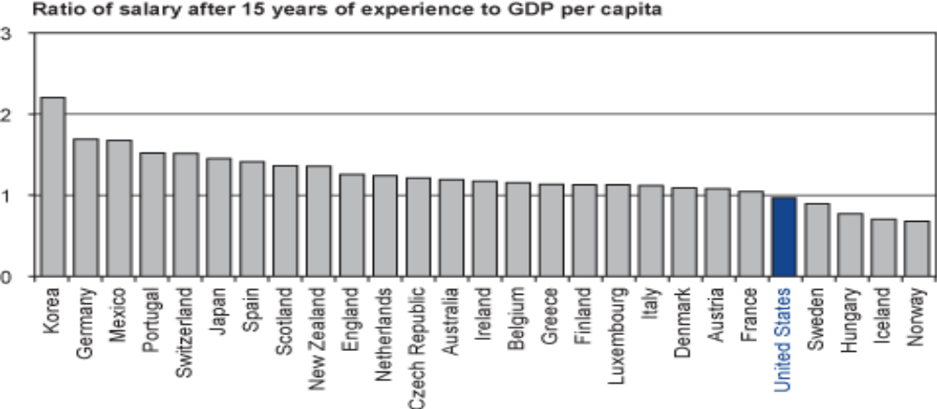
How to Overcome Barriers and Misconceptions of STEM Education in the United States
Another Issue Beyond the Barriers and Misconceptions
Figure 1
Secondary Teachers’ Salary Relative to GDP in OECD Nations

Slide 13
How to Overcome Barriers and Misconceptions of STEM Education in the United States
How to Overcome these Barriers and Misconceptions
Motivating non-STEM workforce to join the STEM pipeline
Partnership of private and philanthropic groups with local and state government is essential
Collaborating with other education organizations, the private sector, and local community organizations
Sharing the vision for motivating workers to join the STEM pipeline

Slide 14
How to Overcome Barriers and Misconceptions of STEM Education in the United States
How to Overcome these Barriers and Misconceptions
Coherent strategy and sufficient leadership should be taken by the federal government
Students from elementary to graduate levels need to be targeted for STEM Education
STEM initiatives should be monitored in K-12 levels
Prepare Sufficient Number of middle and high school level STEM teachers
U.S. must provide more investment in supporting teacher preparation programs in STEM subjects

Slide 15
How to Overcome Barriers and Misconceptions of STEM Education in the United States
Conclusions
The solution to the STEM education problem should be handled in an interdisciplinary manner
Success in STEM requires both technical and nontechnical skills and dispositions
Mathematics and science knowledge are an important base for all STEM workers
Students need to be inspired in STEM subjects beginning in the middle school grades

Slide 16
How to Overcome Barriers and Misconceptions of STEM Education in the United States
References
  Borjas, G. J. (2004). Do Foreign Students Crowd Out Native Students from Graduate. NBER Working Paper No. w10349. Retrieved March 12, 2010, from http://papers.ssrn.com/sol3/delivery.cfm/ nber_w10349.pdf?abstractid=515243
  Brush, T., Glazewski, K. D., & Hew, K. F. (2008). Development of an instrument to measure preservice teachers’ technology skills, technology beliefs, and technology barriers. Computers in the Schools, 25(1-2), 112-125.
  Ingersoll, R., & Perda, D. D. (2010). Is The Supply of Mathematics and Science Teachers Sufficient? American Educational Research Journal, 47(3), 563-594. Retrieved November 12, 2010, from http://aer.sagepub.com/content/early/2010/05/13/0002831210370711.full.pdf+html
  Johnson, R. Y., Chubin, D. E., & Malcom, S. M. (2010). Education and Human Resources in the FY 2010 Budget: Investing in the Future of STEM Education.Research and Development FY 2010, AAAS Report XXXIV: Chapter 4, Intersociety Working Group, American Association for the Advancement of Science (2009). Retrieved December 18, 2011 from http://www.aaas.org/spp/rd/rdreport2010/ch04.pdf
  Kuenzi, J. J. (2008). Science, Technology, Engineering, and Mathematics (STEM) Education: Background, Federal Policy, and Legislative Action. CRS report for Congress. Retrieved April 18, 2009 from http://www.fas.org/sgp/ crs/misc/RL33434.pdf.

Slide 17
How to Overcome Barriers and Misconceptions of STEM Education in the United States
References
  Kurz, T. & Middleton, J. (2006). Using a functional approach to change preservice teachers’ understanding of mathematics software. Journal of Research on Technology in Education, 39(1), 51-71.
  Levinson, E. M., & Palmer, E. J. (2005). Preparing Students with Disabilities for School-to-Work Transitions and Postschool Life. Retrieved April 10, 2010 from http://www.nasponline.org/resources/principals/Transition%20Planning%20WEB.pdf
  National Center on Education and the Economy (2006). Tough Choices or Tough Times: Report of the New Commission of the Skills of American Workforce. Washington, DC: John Wiley & Sons, Inc.
  National Center for Education Statistics. (2009). The Condition of Education. Retrieved November 12, 2010, from http://nces.ed.gov/programs/coe/2010/section5/indicator39.asp
  National Science Board. (2008). Science and Engineering Indicators: 2008. Arlington, VA: National Science Foundation.

Slide 18
How to Overcome Barriers and Misconceptions of STEM Education in the United States
References
  National Science Teachers Association (NSTA). (2008). NSTA New Science Teacher Academy. Retrieved December 12, 2008, from http://www.nsta.org/academy/
  Obama, B. (2009). What Science Can Do. ISSUES in Science and Technology, 25th Anniversary Issue, 25(4), 23-30.
  Organization for Economic Co-operation and Development [OECD]. (2009). Education at a Glance 2009: OECD Indicators. Washington, DC: OECD. Retrieved March 12, 2010, from http://www.oecd.org/edu/eag2009.
  President’s Council of Advisors on Science and Technology (PCAST). (2010). Prepare and Inspire: K-12 Education in Science, Technology, Engineering, and Math (STEM) for America’s Future. Retrieved November 13, 2010, from http://www.whitehouse.gov/sites/default/files/microsites/ostp/pcast-stemed-report.pdf
  Sanders, T. (2004). No Time To Waste: The Vital Role of College and University Leaders in Improving Science and Mathematics Education. Retrieved February 16, 2010, from www.ecs.org/html/Document.asp?chouseid=5480
  Setda.org. (2008). Science, Technology, Engineering & Math. Retrieved February 16, 2010, from http://www.setda.org/c/document_library/get_file?folderId= 270&name=DLFE-257.pdf

Slide 19
How to Overcome Barriers and Misconceptions of STEM Education in the United States
References
  Taylor, J., Harris, M. B., & Taylor, S. (2004). Parents Have Their Say… About Their College-Age Children’s Career Decision. Retrieved April 10, 2010 from http://www.uncw.edu/Stuaff/career/documents/ parentssay%5B1%5D.pdf
  Terrel, N. (2007). STEM Occupations. Occupational Outlook Quarterly, Spring, 2007, 26-33. Retrieved February 16, 2010, from www.bls.gov/opub/ooq/2007/spring/art04.pdf
  Wasserman, L. (2008). Compiled Perspectives on STEM Education. Retrieved February 16, 2010, from http://www.nsf.gov/nsb/meetings/2009/0824/ Louis_Wasserman_Compiled_Perspectives_on_STEM_Education.pdf
  Watts-Taffe, S., Gwinn, C. B., Johnson, J. R., & Horn, M. L. (2003). Preparing preservice teachers to integrate technology with the elementary literacy program. The Reading Teacher, 57, 130-138.
  Woullard, R., & Coats, L. T. (2004). The community college role in preparing future teachers: The impact of a mentoring program for preservice teachers.Community College Journal of Research & Practice, 28(7), 609-624.

Slide 20

Thank you.
How to Overcome Barriers and Misconceptions of STEM Education in the United States
Md. Mokter Hossain
Doctoral Candidate in
Mathematics Education
University of Nevada, Reno.
Mokter@unr.edu

